Slide 1

Opposing Europe? euroscepticism and the critical discourse of the EU
Prof. Marco Baldassari
m.baldassari@collegioeuropeo.it
Collecchio – 17 September 2016

Slide 2

Table of contents
Some critical remarks on the notion of “euroscepticism”.
A brief history of the positions opposing the europeanisation process.
The critique to the European governance
Post-democracy and economic crisis
Conclusions

Slide 3
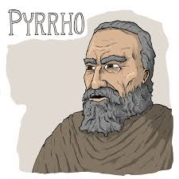
Some critical remarks on the notion of “euroscepticism”
Ancient Scepticism
“The Greek word “skepsis” means investigation. By calling themselves skeptics, the ancient skeptics thus describe themselves as investigators.
They also call themselves ‘those who suspend’, thereby signaling that their investigations lead them to suspension of judgment. […]
At its core, ancient skepticism is a way of life devoted to inquiry.”
To put reality into question

Slide 4
Some critical remarks on the notion of “euroscepticism”
“Euroscepticism” (“Europessimism” or “Europhobia”) ?
A “catch-all” term. A sort of generalisation of the anti-european positions.
“scepticism” vs “opposition” (how to de-politicize the public opinion).
heterogeneous and multidimensional phenomenon (it is better to define e. as a plurality of a diversified forms - different nuances of critiques, oppositions, rejections of the EU) or
“the idea of contingent or qualified opposition, as well as incorporating outright and unqualified opposition to the process of European integration” (Paul Taggart)
Question:
Is “euroscepticism” a sort of “pathology” of the European society?

Slide 5
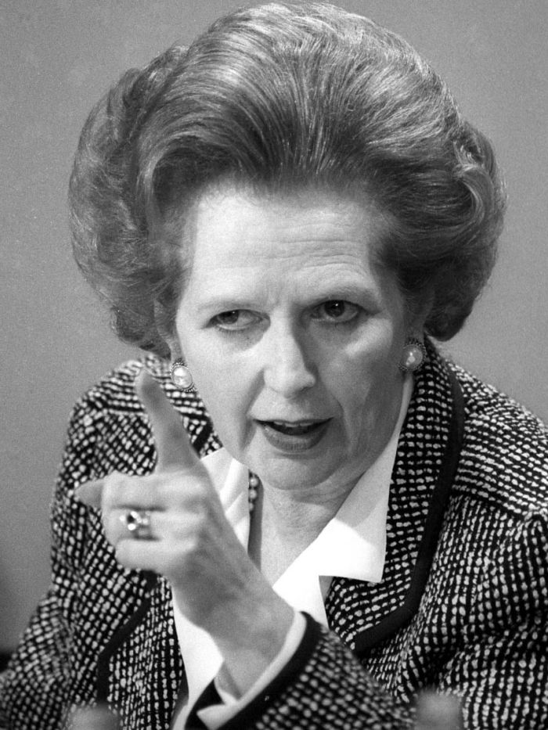
A Brief history
“I want my money back”
The term originates in 1985, and was used to indicate the Great Britain opposition to the European project.
Margaret Thatcher speech at the College of Europe in 1988.
The claim for the UK “rebate”.
1957: Economic Economic Community. Opposition by the communist parties and by nationalists.
1954: The first European crisis (the failure of the European Defense Community).
1965: The crisis of the “empty chair” and general de Gaulle French opposition to the “eurocrats”.
Seventies: eurosclerosis.
2004: the failure of the Constitutional Treaty

Slide 6
The critique of the European governance
Putting into question the irreversibility principle of the European integration process.
The European integration process was characterized by
a functionalist and progressive integration approach (“spill over” effect).
a supranational dimension combined with a strong intergovernamentalism.
a transfer of sovereignty towards European institutions
a social-market economy model alternative to the social-democratic project as well as to liberalism and pure free market economy.

Slide 7
The critique of the European governance
ECSC
1951
Coal and Steal Community
EEC
1957
The idea to create a COMMON MARKET
SEA
1986
Relaunching the integration project
And the completion of the SINGLE MARKET
Treaty of Maastricht
1992
Three pillars arcitecture. EC – CFSP - JHA.
The bases for the MONETARY UNION
Treaty of Amsterdam 1997
Stability and Growth Pact
Treaty of Nice
2001
Charter of Fundamental Rights
Treaty of Lisbon
2009
New institutional architecture and launching of a new economic governance
A linear path towards a growing europeanisation?
From an economic → to a POLITICAL community?

Slide 8
Euroscepticism: a categorisation
Democratic euroscepticism
(critique of the democratic deficit)
Utilitarian euroscepticism
(benefits/costs for the country, not “Europe” as a whole)
“No global” euroscepticism
(critique to the neoliberal Europe and to the austerity measures)
Sovranism
(the identitarian or/and national claim towards the popular sovreignty)

Slide 9
Post-democracy and crisis of governance
“The end of the “permissive consensus” (Majone), and the beginning of postdemocracy (Crouch).
European elections and decreasing of participation from 1979 to 2014.
The problem of the legitimization of the EU and the end of the “postwar grand narrative”: EU = peace → EU = growth

Slide 10
Post-democracy and economic crisis
"The severity of the crisis is due to a fundamental contradiction: what would need to do urgently is extremely unpopular and therefore virtually impossible in a democratic context. What you should do, and on which everyone agrees in principle (that is, a large-scale debt mutualisation and long term, which would lead to massive redistributive measures both between member states and between social classes), it cannot be proposed to member states' voters who have so far been less affected by the crisis than those of the periphery".
(Claus Offe)

Slide 11
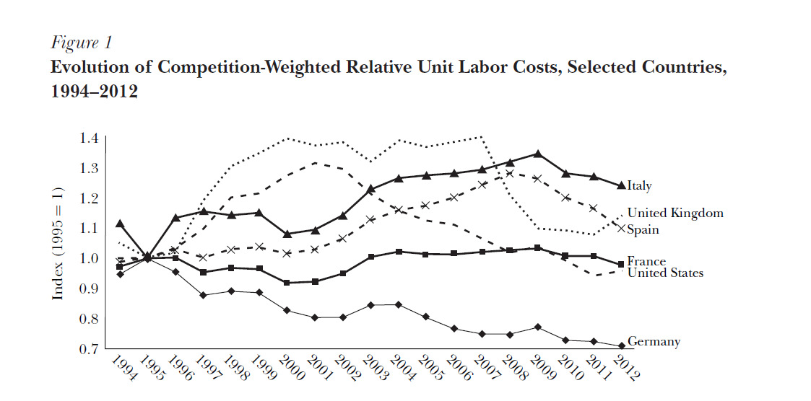
Post-democracy and economic crisis
In Italy the cost of labor per employee increased in line with inflation
while productivity has had a very significant decline

Slide 12
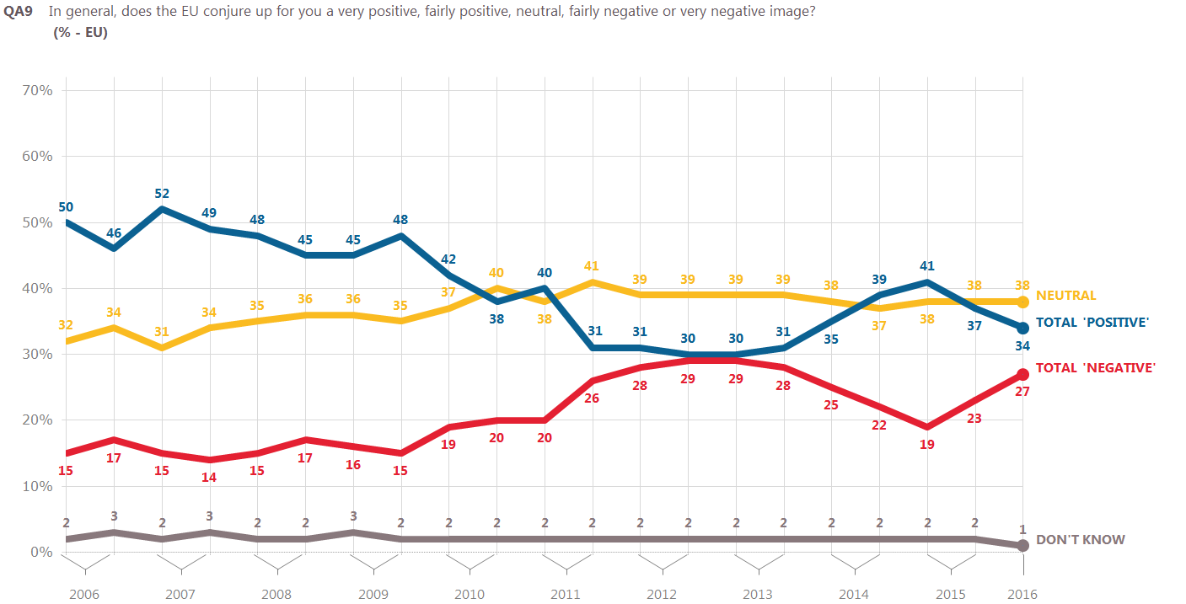
Post-democracy and economic crisis

Slide 13
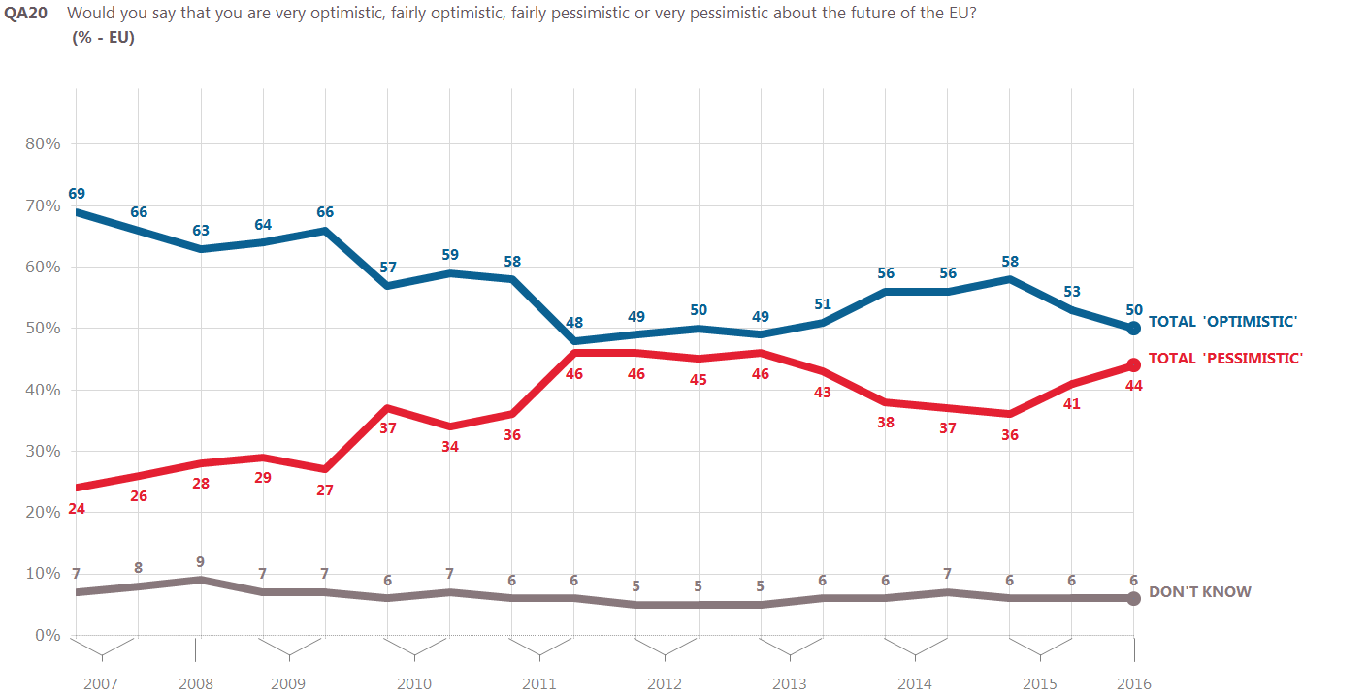
Post-democracy and economic crisis

Slide 14
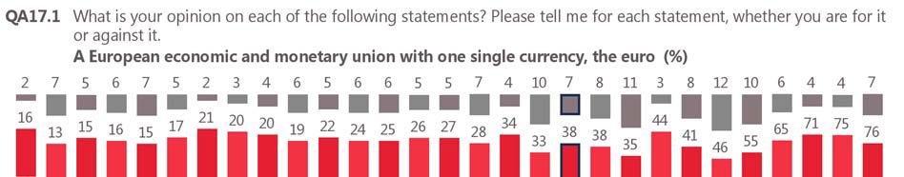
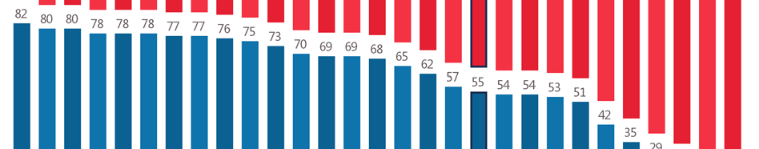
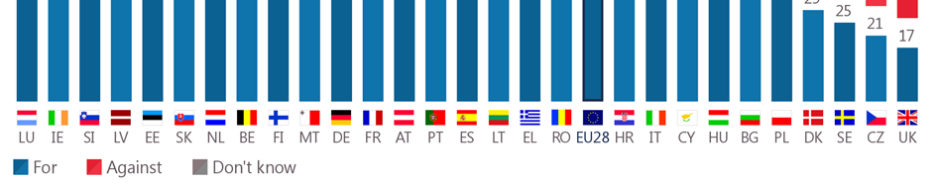
Post-democracy and economic crisis

Slide 15
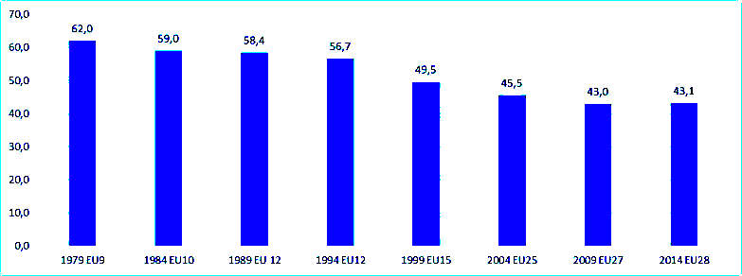
Post-democracy and economic crisis
Partecipation to the elections 1979-2014
(Source: Eurostat)

Slide 16
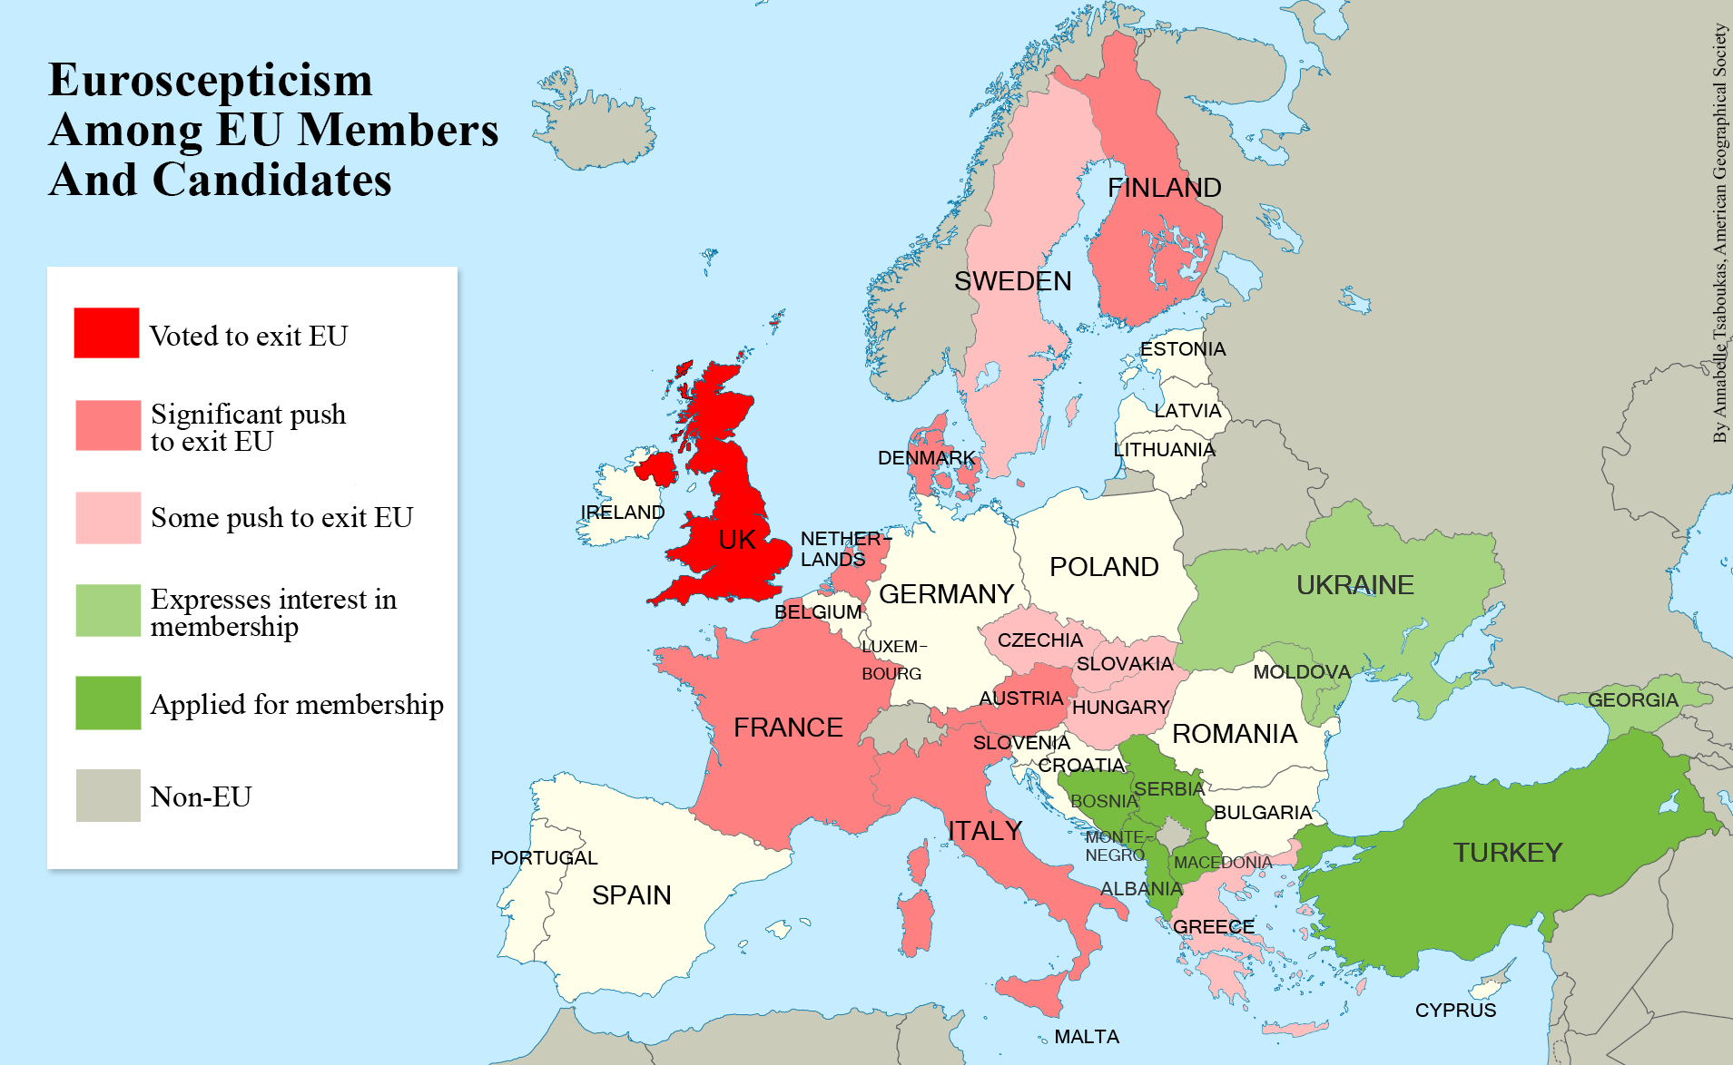
Post-democracy and economic crisis

Slide 17

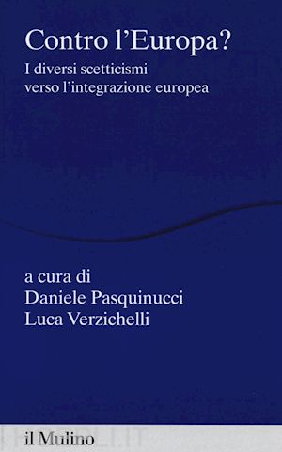
Readings to learn more
Policy paper n. 121, 2014 - by Notre Europe (Jacques Delors’ think tank) EUROSCEPTICISM OR EUROPHOBIA:
VOICE VS. EXIT?
Yves Bertoncini | Director of Notre Europe - Nicole Koenig
→ http://www.institutdelors.eu/media/euroscepticismoreurophobia-bertoncini-koenig-ne-jdi-nov14.pdf?pdf=ok

Slide 18
Thank you!

Slide 19
